Slide 1
Network Fundamental Capstone Project

Slide 2
Infrastructure
Company Name: Speedwell
Internal Network, DMZ, and Internet
3 pcs + 1 laptop + 1 printer + 3 switch + 3 servers (DHCP, DNS and Website) + 2 routers + Sniffer + 1 access point

Slide 3
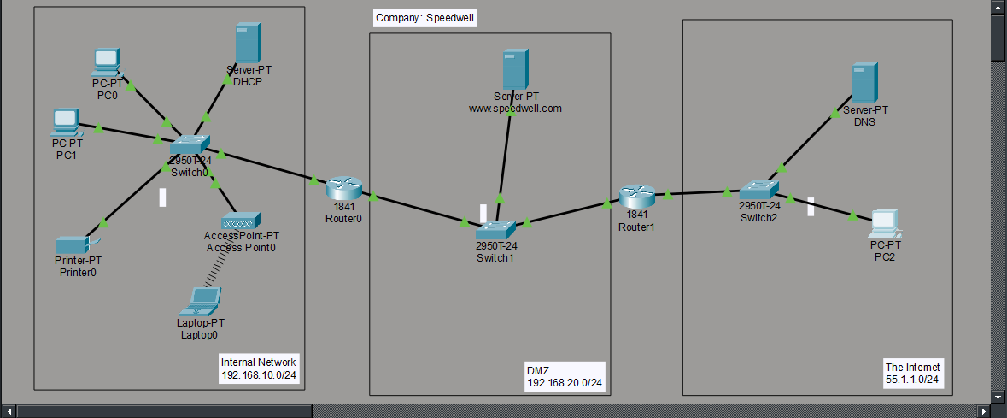
Network into internal and dmz. The public server is www.speedwell.com and is hosted on DMZ

Slide 4
Internal Network: 192.168.10/24
We have 2 wired employees and one wireless connected via AP. All their IP is from the DHCP whereas printer is a static IP

Slide 5
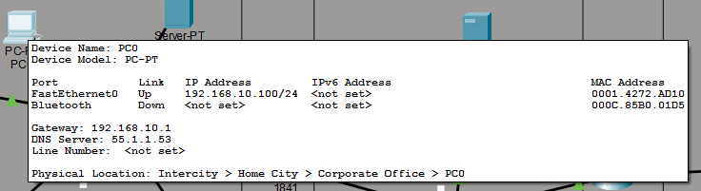
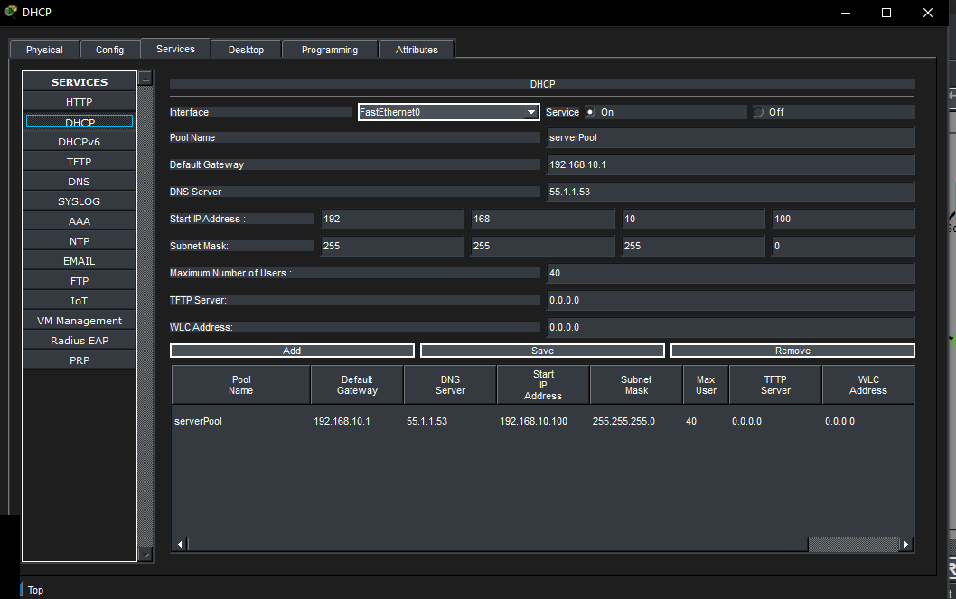
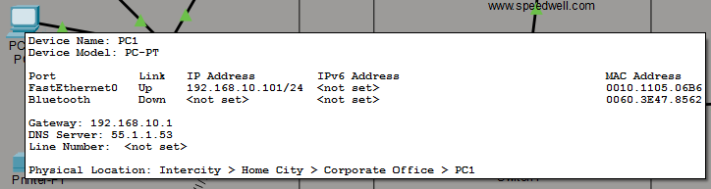
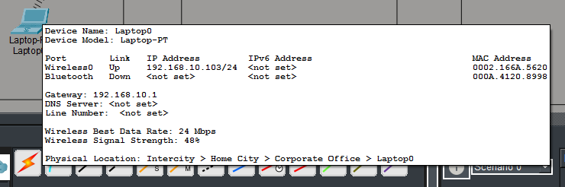
Internal Network Configs

Slide 6
DMZ Section
Ip is 192.168.20.0. the DMZ will host the web server. This is a NAT router user config

Slide 7
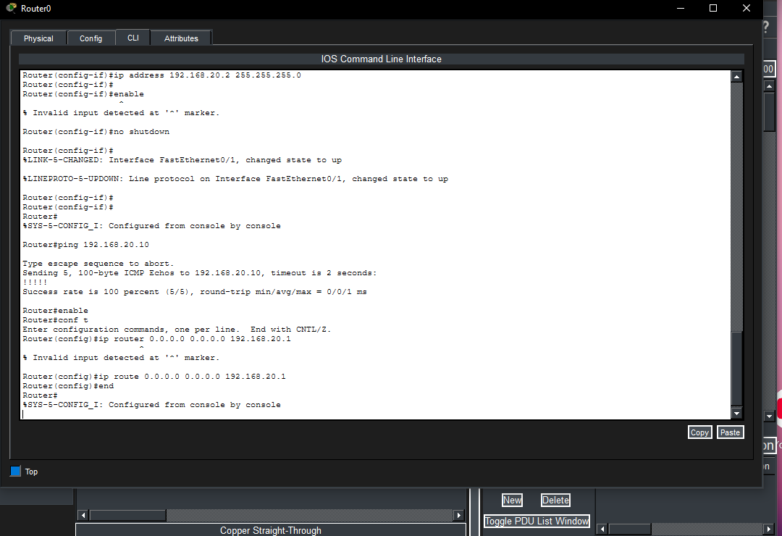
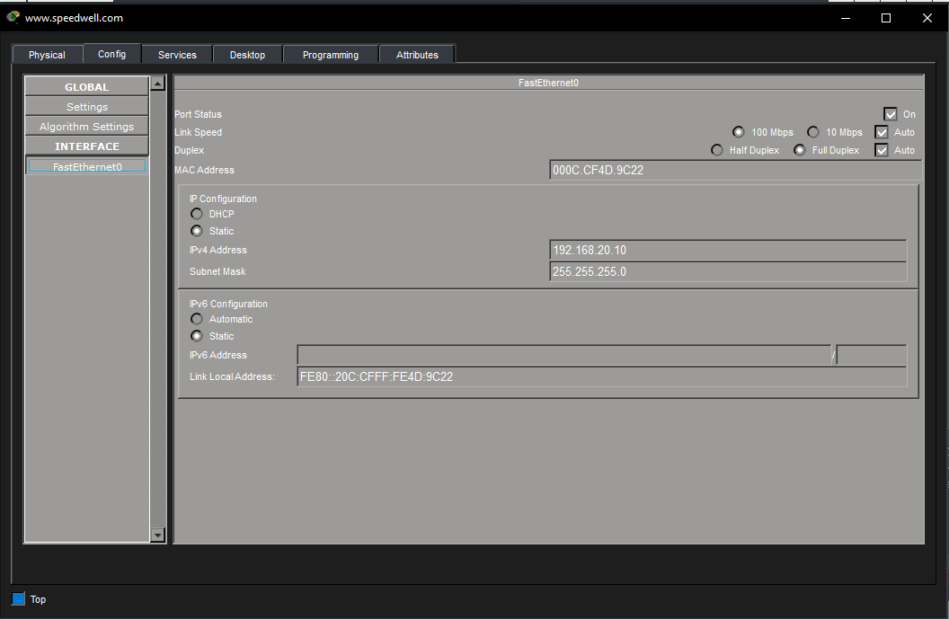
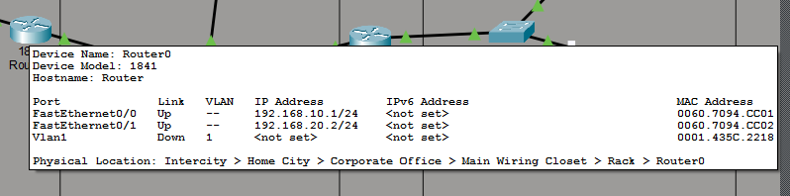
DMZ Configs

Slide 8
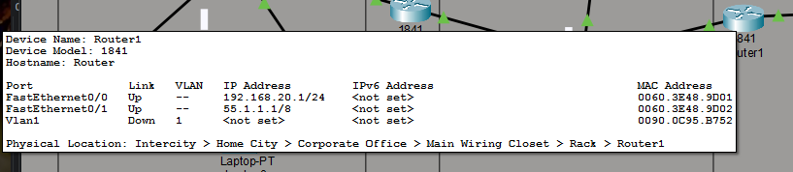
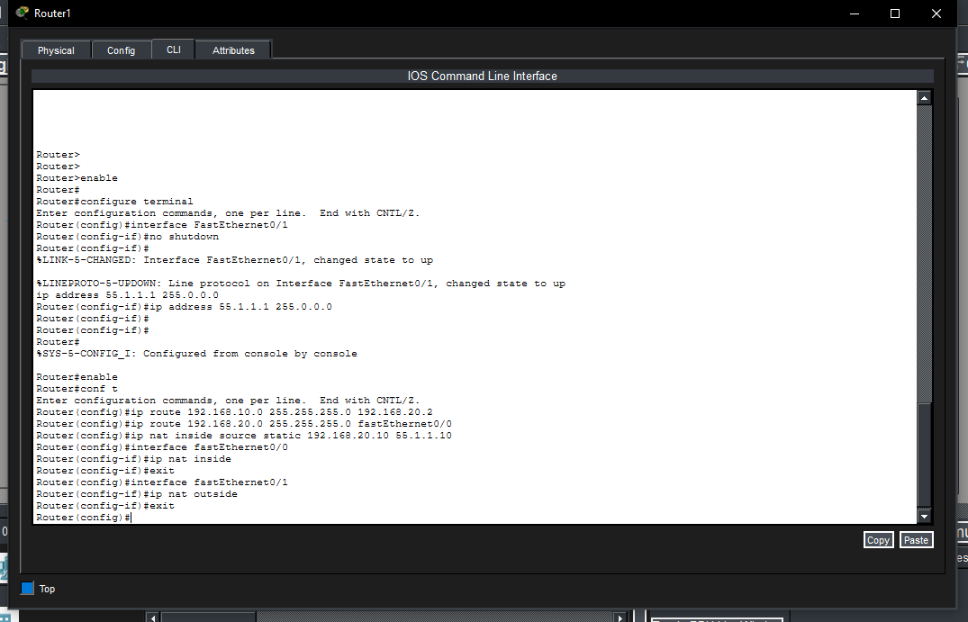
DMZ Configs 2

Slide 9
The Internet
The Ip is 55.1.1.0
We are simulating the internet here
We have a dns that will help us with access the speedwell.com site and we have a user

Slide 10
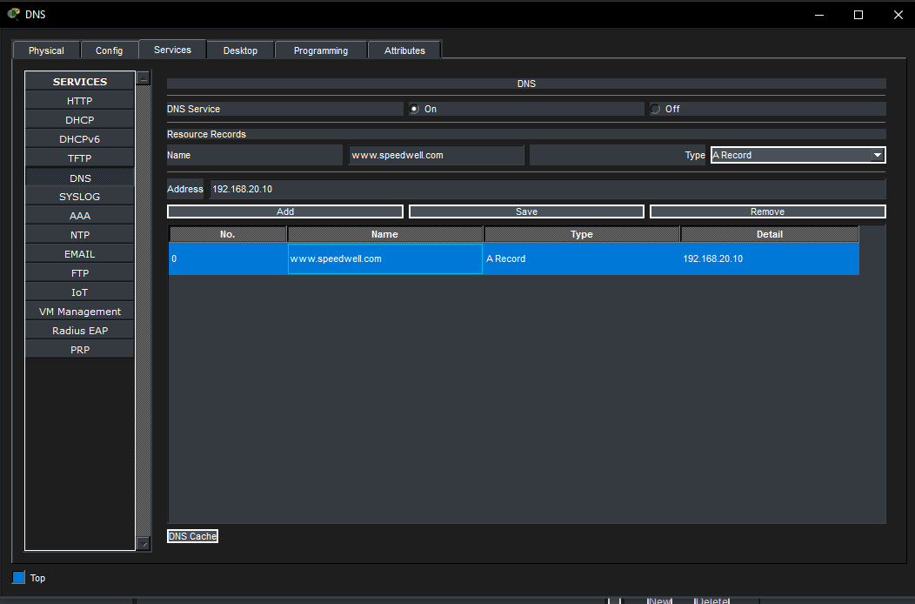
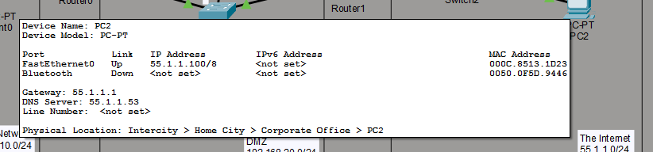
Config
Dns will help PC2 and the other employees in the internal network to open the site

Slide 11
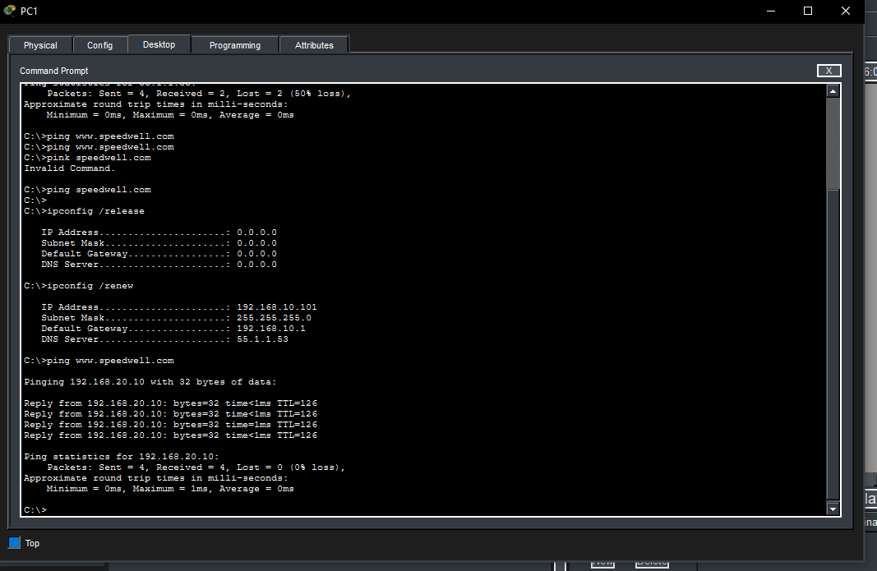
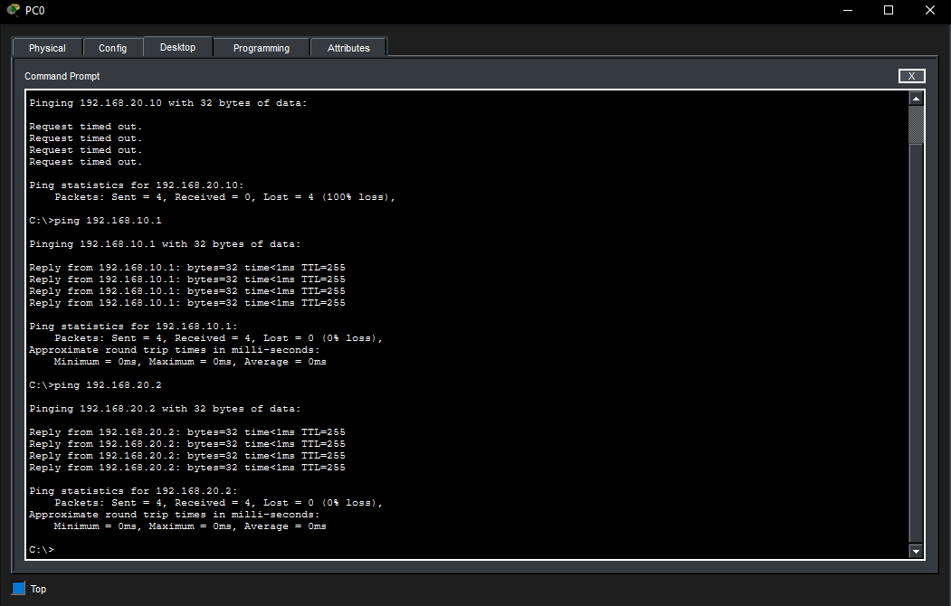
Tests ping PC1 & Pc0 to router and site

Slide 12
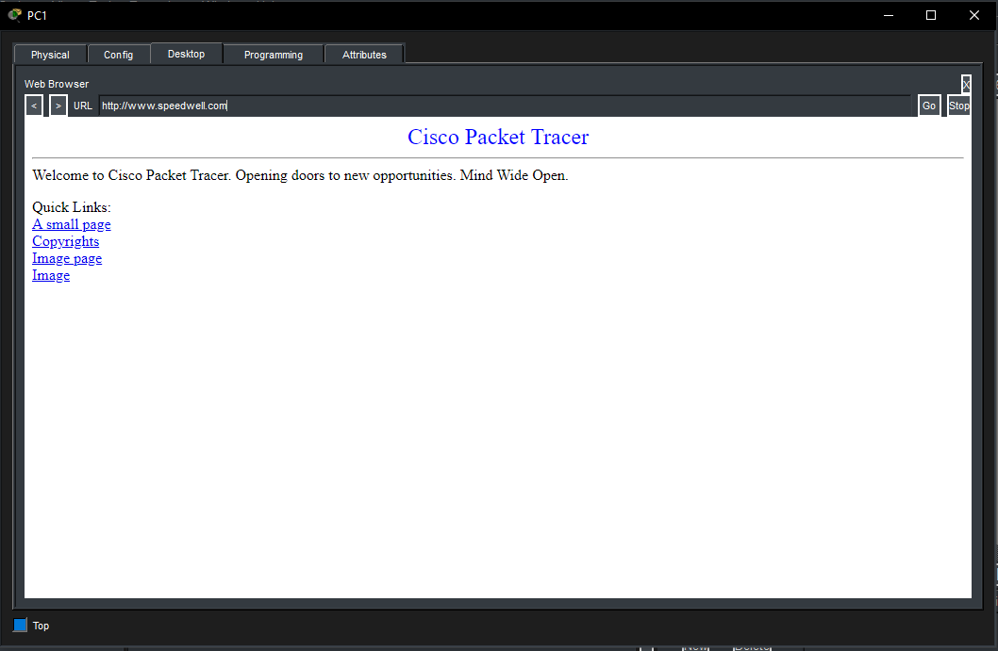
Tests site PC1
We tested ping before we set the Nat and after we did and finished the DNS and renewed our DHCP then checked the site

Slide 13
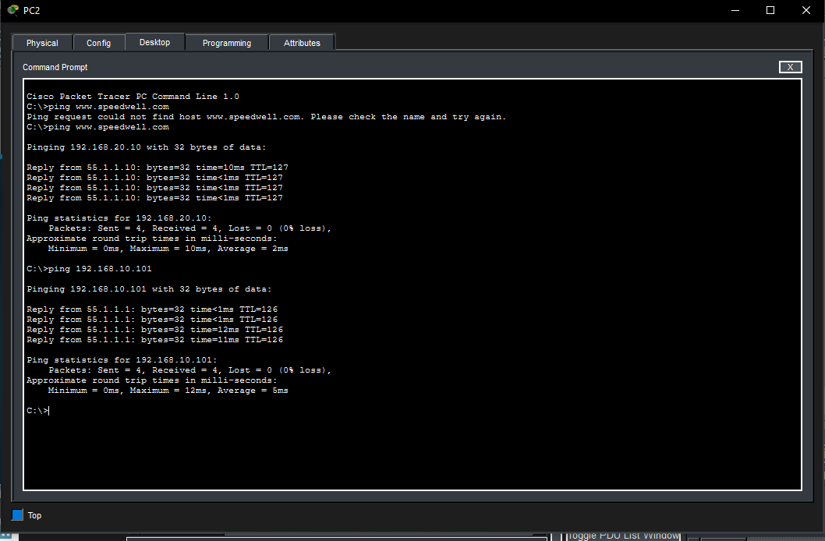
Tests PC2
Tested pc2 to one of the pcs and the site as well

Slide 14
This is configed so we can access the site safely
NAT config

Slide 15
Thank you

